Slide 1
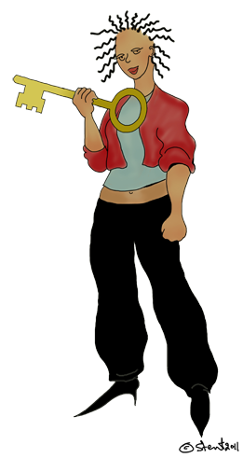


@AfriNEAD
(African Network for Evidence-to-Action on Disability)
2011 Symposium
Victoria Falls, Zimbabwe
The Human Rights Key
Veronica Mitchell
School of Public Health & Family Medicine
University of Cape Town
South Africa
Veronica.Mitchell@uct.ac.za

Slide 2

Trust
Theme
Dependence
Reliable
Protection
Hope

Slide 3
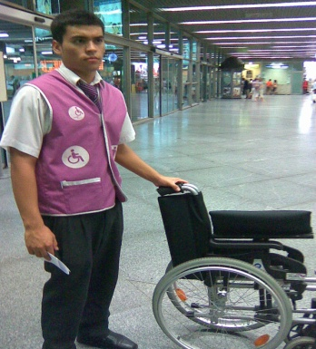
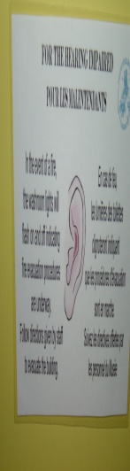
at others …
Looking in

